Slide 1
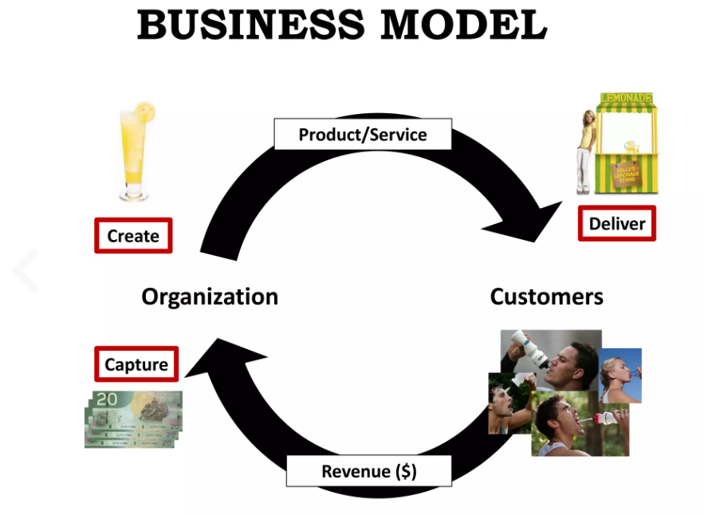

Slide 2
Describe
Discuss
Design
Challenge
Improve
Innovate
Invent
Pivot
Choose

Slide 3
So, what does a business model canvas include?
Customer Segments
Whether its B2B or B2C, all businesses have customers. These are the people or organizations that buy your products, use your service or are otherwise essential for creating a profit.
Customers can be defined through various means but it’s important to focus on the core customers first, then assess less critical or potential future clients. The canvas should assess, among other factors:
Current and future needs: what are customers looking for, and what might they be looking for in the immediate future?
General demographic: age range, location, interests, etc
Likes, dislikes and pain points: what do your customers enjoy and what puts them off? Knowing this will help understand how best to approach them.
Relations with other segments: this is important if your business relies on multiple groups interacting. Airbnb, for example, has both property owners and guests - the business strategy only works if both are satisfied.
Additionally, you can list additional segments that may utilize the product or service in the future. This will highlight future directions the strategy can go in, once success has been gained with the core, primary audience(s).

Slide 4
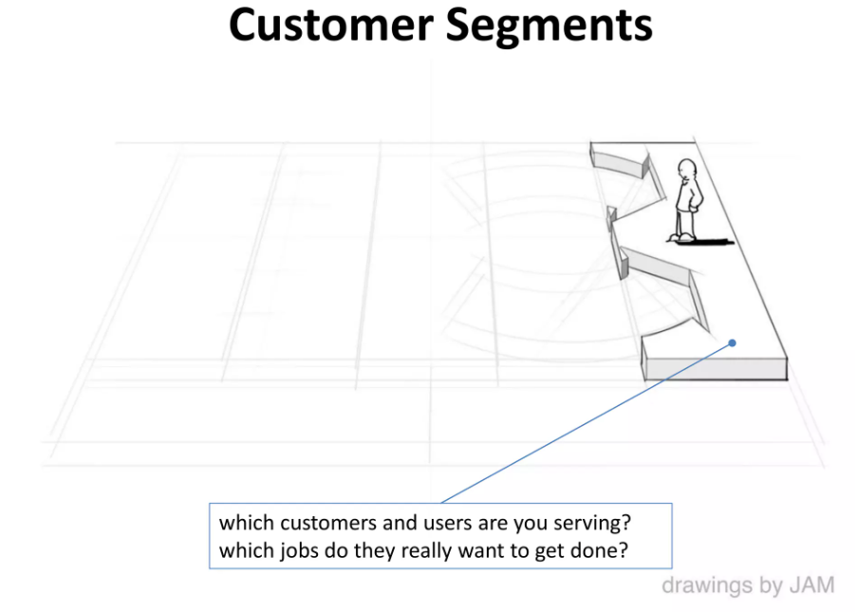

Slide 5
Value Proposition
A company’s value proposition is the sum of its various products and services, specifically in regards to how it uniquely stands out amongst the competition. In layman's terms: what is the unique factor that makes this business better than another?
The creator of the business model canvas, Osterwalder has also stated that organizations need to offer something unique and, what’s more, this needs to be immediately discernible from the competition.
The value proposition can be as simple as being cheaper, faster, more efficient or more readily available than the competition. However, we can roughly place all values in two broad categories:
Quantitative. This refers to benefits that can be easily counted; from a customer’s point of view, this means they can be easily compared to the competition. Examples of this can include pricing or speed. Users may very well choose your service because it's cheaper or quicker.
Qualitative. This refers to abstract concepts such as value or experience - those that can’t be readily measured by hard numbers, but nonetheless, give a strong emotional response to your audience. Examples of this can include various characteristics, such as using local products, being eco-friendly or having a personal, customer-centric approach that competitors lack.
Another way of expressing the core value is by asking what you want customers to remember. When it comes to recommending your business to others, what’s the essential benefit that people should mention? This is the value that your organization needs to drive - so it needs to be on the canvas.
Of course, your value also needs to be maintained. For instance, if your value lies in being the only service in a respective region, what will happen when a larger competitor eventually decides to move in? The business model canvas should highlight these weaknesses, in order to better plan ahead.

Slide 6
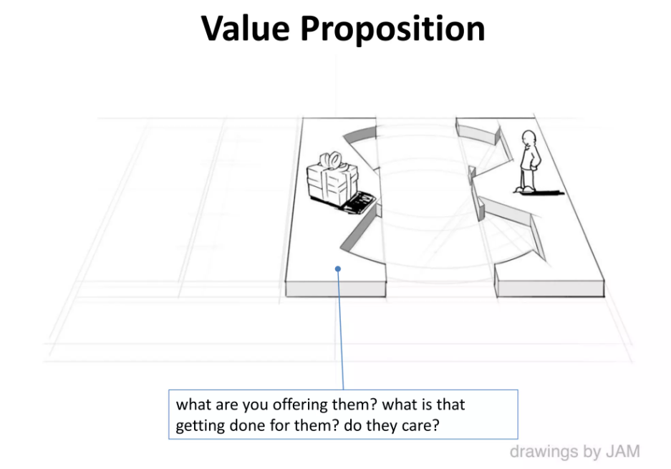

Slide 7
Channels
How will you and your customer interact? Once you define your customer, as well as flesh out your unique value, this will impact what channels you use.
For example, if your audience is busy and on the go, a mobile-facing service will be essential. Likewise, if you’re targeting specific locations, perhaps a physical presence is also needed? What’s important here is that you consider the many touchpoints that your customers may want and highlight the beneficial ones.
However, it should be noted that channels can adapt over time and this is one area where the business model canvas is likely to be updated.
For example, when Domino’s first started, there were only a handful of options, namely dialing the store or visiting in-person. The invention of the internet and mobile apps quickly changed this and now there are over 10 different ways.
Yet the decision to expand with new digital products didn’t just happen on a whim; the business model canvas considered the customer needs (efficiency and a desire for less effort) with their value proposition (making food ordering and delivery as easy as possible) to define new channels.

Slide 8
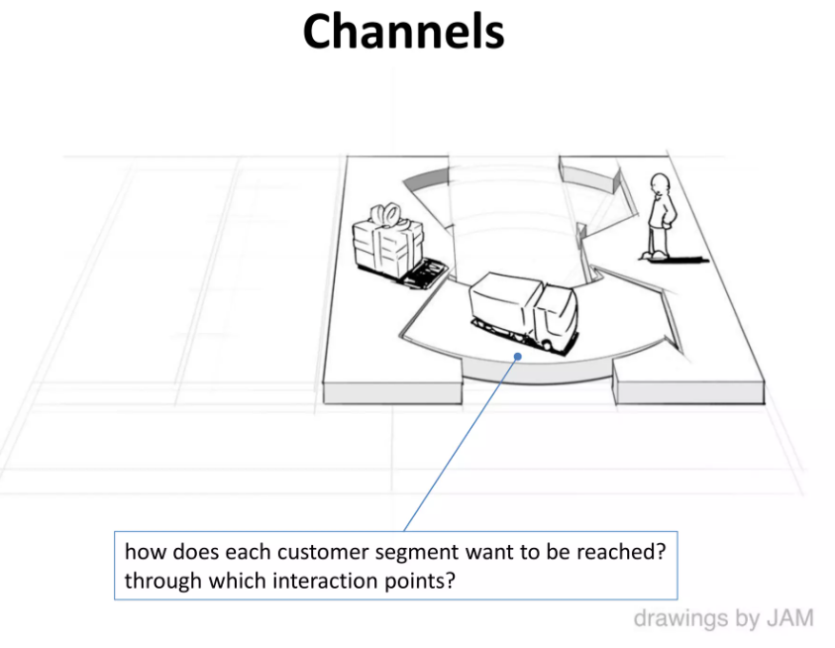

Slide 9
Customer Relationships
This section covers your relationship with each customer. This includes how customers first came to use your business, how you kept these initial customers and, ultimately, how the business will grow its audience.
There are a number of factors to consider here, especially in regards to the type of relationship you want:
Personal Assistance. In these forms, customer service is essential. Clients want a personal approach from your company and, in turn, you offer a direct approach tailored to their specific needs. This often involves having employees attached to specific customers (such as a sales or business development position) both before and after the sale process itself. This is something a bank might have for its business clients, for example. How dedicated this exact relationship depends on the nature of your service, as well as your customers.
Automation and Self-Service. On the other hand, you might not want to have a direct, personal relationship at all. This can often be found in e-commerce stores, for example; customers just want to browse and shop at will, without speaking to anyone. Automation can enhance this through personalization, without the customer being aware, such as Netflix’s recommended viewing.
Communities. Alternatively, if your target audience is a particular niche, segment or region, you might want to establish a community. In this approach, your business model brings people of shared interests together, to facilitate more actions.

Slide 10
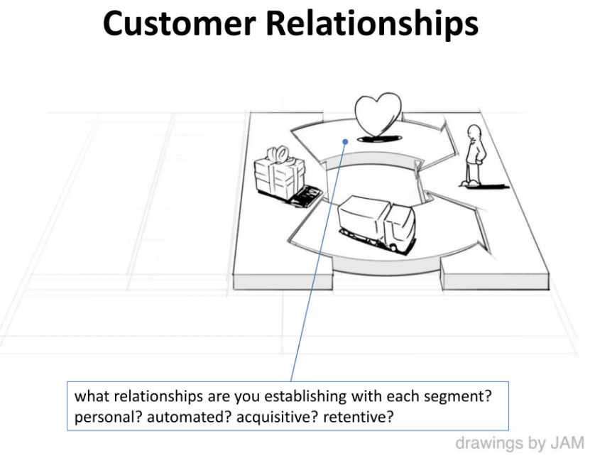

Slide 11
Revenue Streams
Ultimately, a company has to turn a profit. On the business model canvas, this is represented by revenue streams: the various channels with which income can be generated.
Here are the most common revenue streams to consider:
Asset or goods sales: this is one of the oldest streams. By selling goods, the business generates revenue at each transaction.
Subscription: If your providing an ongoing service or rented out products, then these fall under subscription models; your customers pay on a regular schedule (such as per month or year) as long as they are using your business.
Leasing or lending: This is similar to the subscription, but differs in that it’s for a predefined period. Car rentals, for instance, often do this, as customers define the rental period before purchasing. Newer models, however, try to challenge this status quo by offering a more subscription-based service.
Licensing: This is where the business sells licenses to other companies or individuals to use the property. It’s similar to sale, but differs in that you still own the intellectual property; the user can’t resell it.
White labeling: Similar to licensing, white labeling is where you provide a product or service that businesses can relabel as their own. This is typically done as a subscription or one-off license purchase, so it can be considered an additional variant of the above.
Advertising: Perhaps your model is designed to attract users, but currently drive revenue from advertising opportunities? Social media networks are the most famous example of this; they don’t make money through purchases or subscriptions, but through charging advertisers to benefit from this network.
It’s important to note that these revenue streams are not set in stone - they will adapt and evolve as the market changes. As a business, you should regularly return to the canvas to make sure each stream is as effective as it can be. This includes different pricing plans and options (especially if you have multiple streams) or adding new streams, such as with Domino’s, for example.

Slide 12
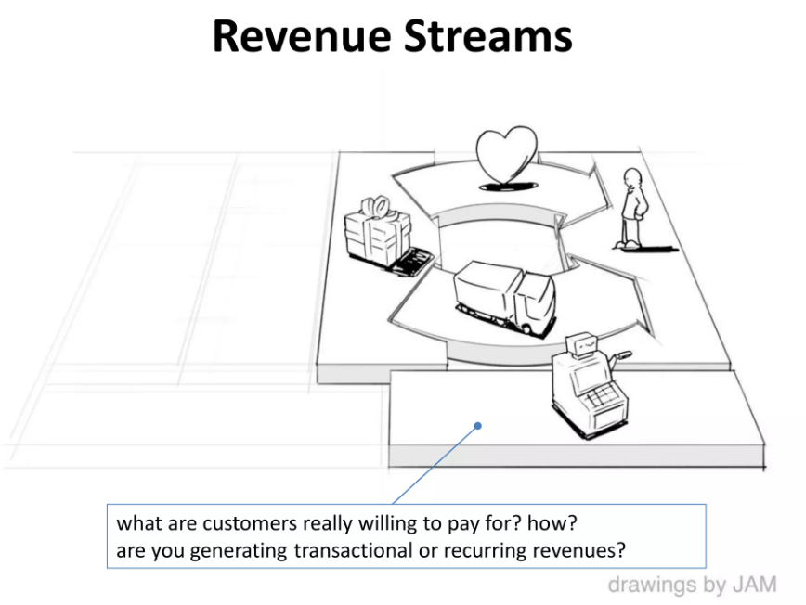

Slide 13
Key Resources
Every organization runs on resources: the essential assets in running the business and providing the value (defined earlier) to customers. Like the other elements, this can come in many forms.
Human resources: if you’re providing personalized value or have a model that requires a lot of staff, the cost and training of employees need to be considered.
Financial: how much investment is required to run and maintain a business before it makes a profit? The more money is needed upfront, the bigger the burden to generate ROI.
Physical: expanding your presence, opening offices or buying physical space is also an asset that needs to be considered. This is mostly true for organizations that need prominent positions, such as high street retailers or hotels. For a lot of businesses, the push into a digital landscape is quickly reducing the strain of this particular resource.
Intellectual property: this can include everything needed to develop your IP (such as an app), as well as develop and maintain it. For example, subscriptions and licenses survive by ensuring customers can not use the service without your business, as you still hold the intellectual property rights.
Through these factors, you should identify what is currently available and what is needed to succeed. Much of this will be defined in your previous channels; this is where you focus on what those channels need to succeed - with an end goal of creating a sustainable business model.

Slide 14
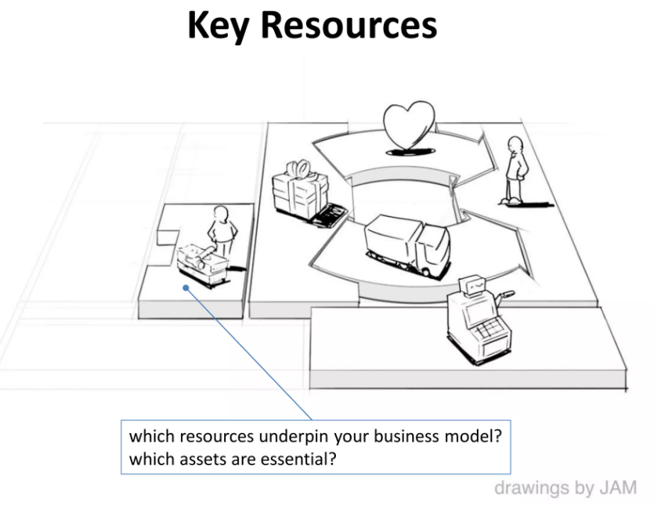

Slide 15
Key Activities
Similar to the last section, what do you need to do to produce your value proposition and ensure it succeeds? This section includes the key activities needed to make your model effective and successfully connect with customers.
This can include initial investment, such as finding a development company, or even marketing and advertising to generate that initial awareness. This section should take everything into account, including the impact each has on the overall business, to understand the absolute essentials and recommended extras.

Slide 16
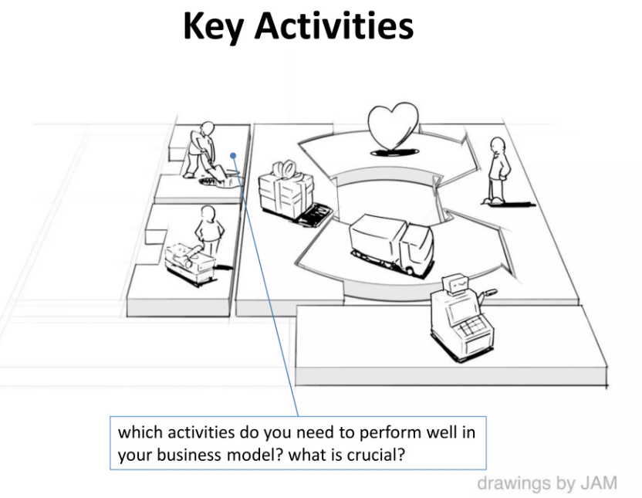

Slide 17
Key Partnerships
Very few companies survive on their own. Identifying and preparing key partnerships is essential for long term survivability. Here are the primary partnerships that you’ll typically need to consider.
Distributors: how will your business sell to customers? Whether its using online stores, sales agents or other companies, you need some form of distribution.
“Coopetition”: sometimes two businesses, that would otherwise be competitors, can join forces to take on larger markets. This works where this is enough potential gains that a joint venture makes more fiscal sense: there isn’t a clear risk of one siding gaining at the expense of the others. For example, smaller organizations can often team up to provide a larger, holistic offer to users, or to even attend events that are outside of either side’s budget.
Suppliers: Similar to distribution, you also need suppliers for everything from raw materials to software development. If there’s something you need and can’t produce in-house, then you need to identify trusted suppliers.
Existing customers: Perhaps if you have existing clients, you can offer some recommendation rewards, or a commission-based system, to spread awareness?
Like everything else, much of this will be subject to change. As the business grows, you might find you no longer need certain partnerships, and likewise need to move to others. All of this should be noted in the business model canvas.

Slide 18
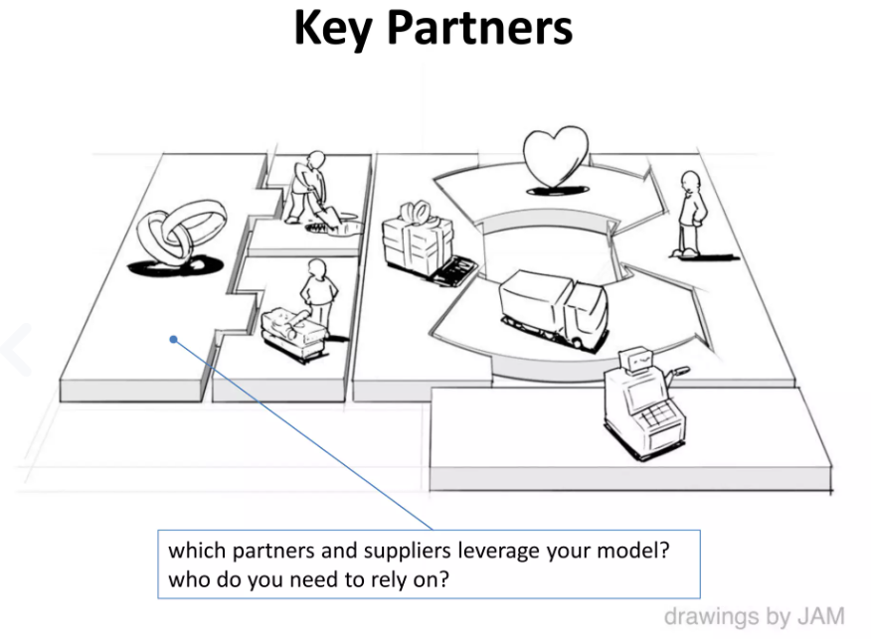

Slide 19
Cost Structure
Finally, as far as business model canvas elements go, you need to define all potential costs. After all, you need to know how much you’ve spent to know when you’re generating profit. The cost structure takes both existing and future costs into account:
Fixed costs are the easiest to determine as they have a singular price or a repetitive price that doesn’t change. Rent is a good example.
Variable costs, on the other hand, can vary and their high peaks need to be accounted for. Factors such as temperature can often impact businesses that need to maintain a certain heat or humidity - they may spend more (or less) in the warmer months.
Economies of scale and scope, similarly, refer to decreasing costs as the business expands. This is because larger production can introduce better efficiencies (scale) while creating new partnerships and improving internal processes, as a result, can improve the wider organization (scope). For example, you might rely on third-party providers for immediate support, such as packaging, but move this in-house when it becomes cost-efficient to do so.
It’s important to understand these variables so that the business model canvas provides a realistic view of costs right now, as well as where the company aims to be short.

Slide 20
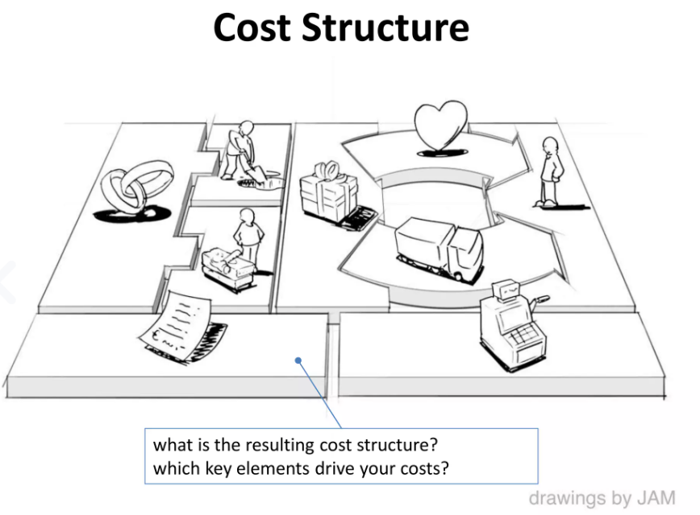

Slide 21
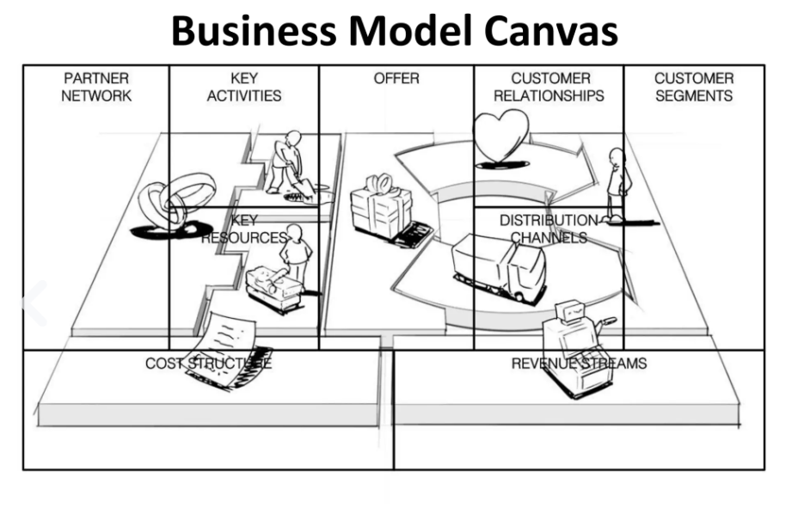

Slide 22
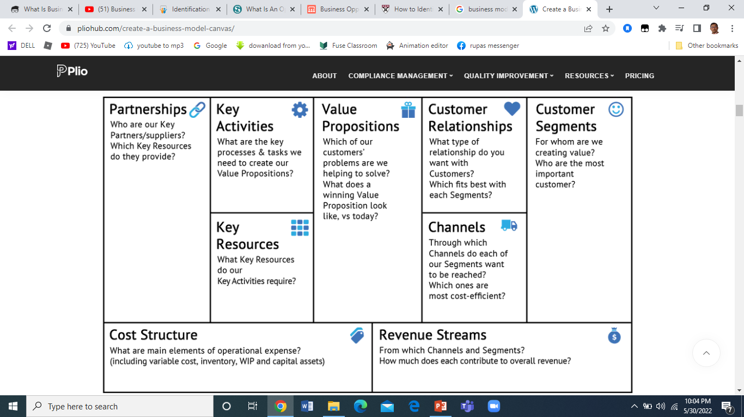

Slide 23
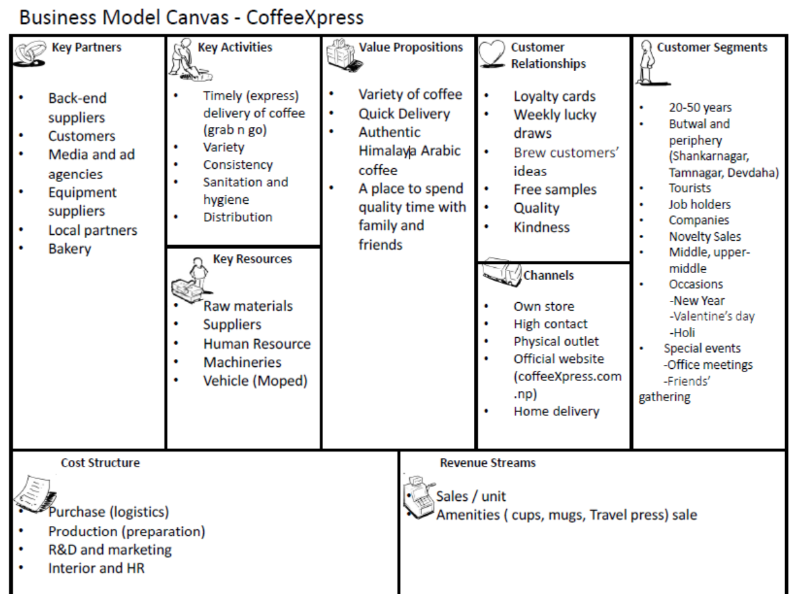

Slide 24
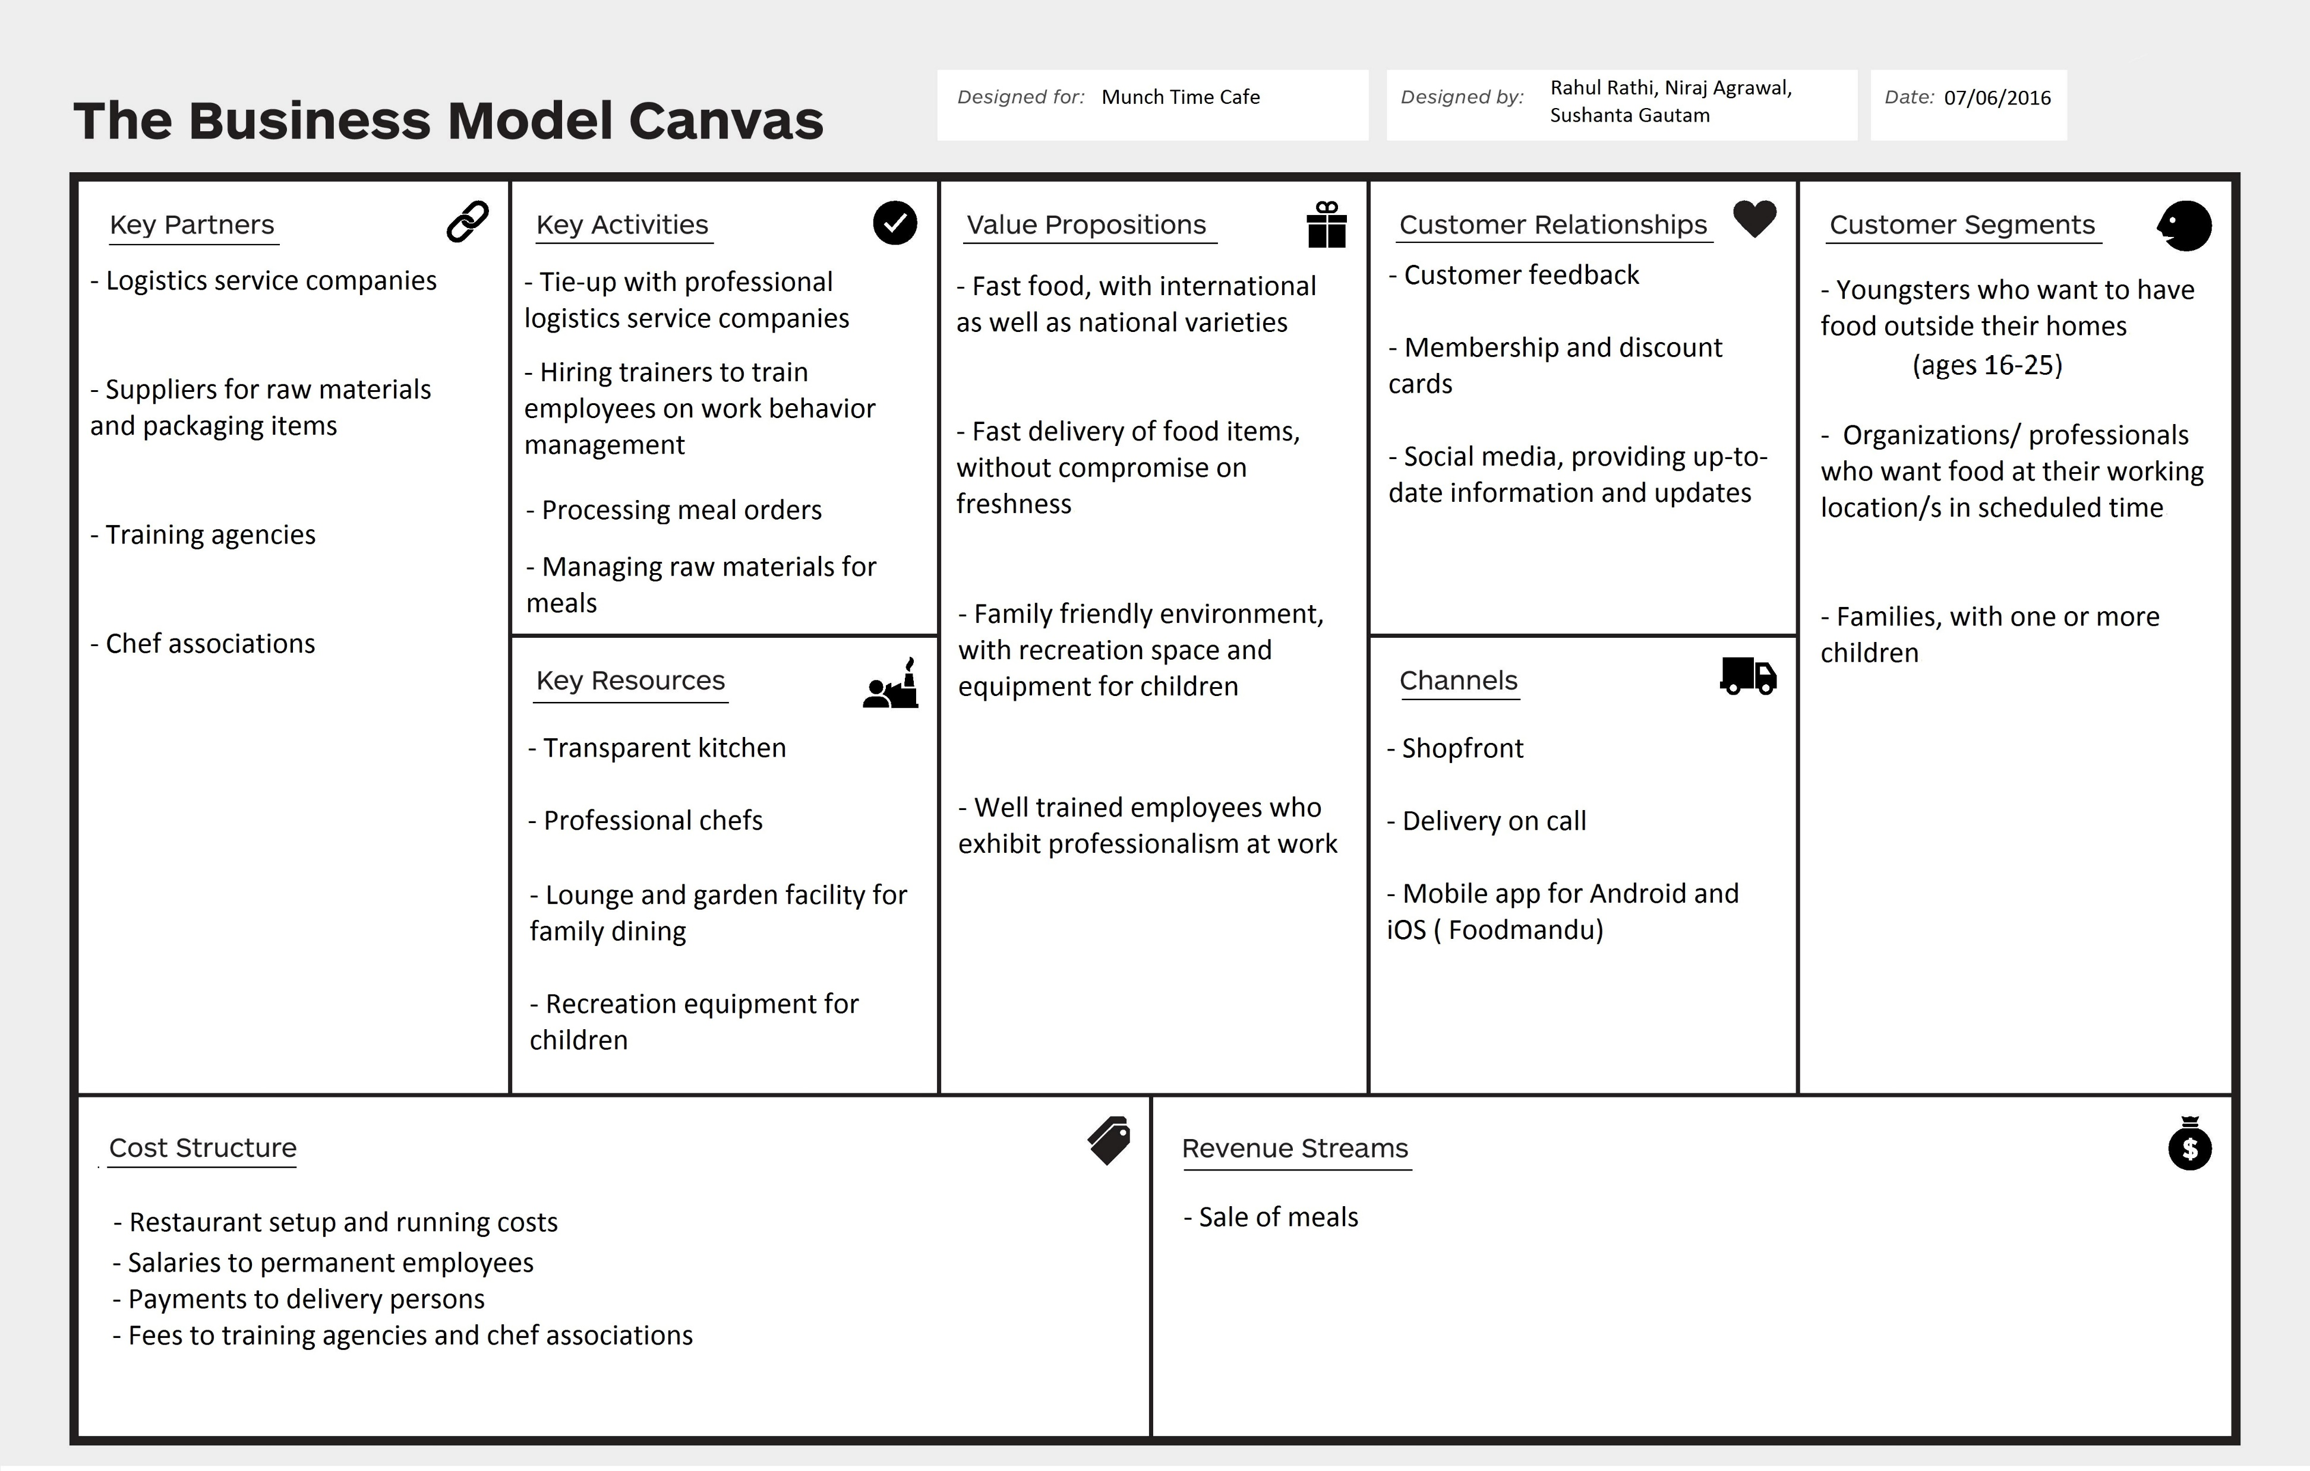

Slide 25
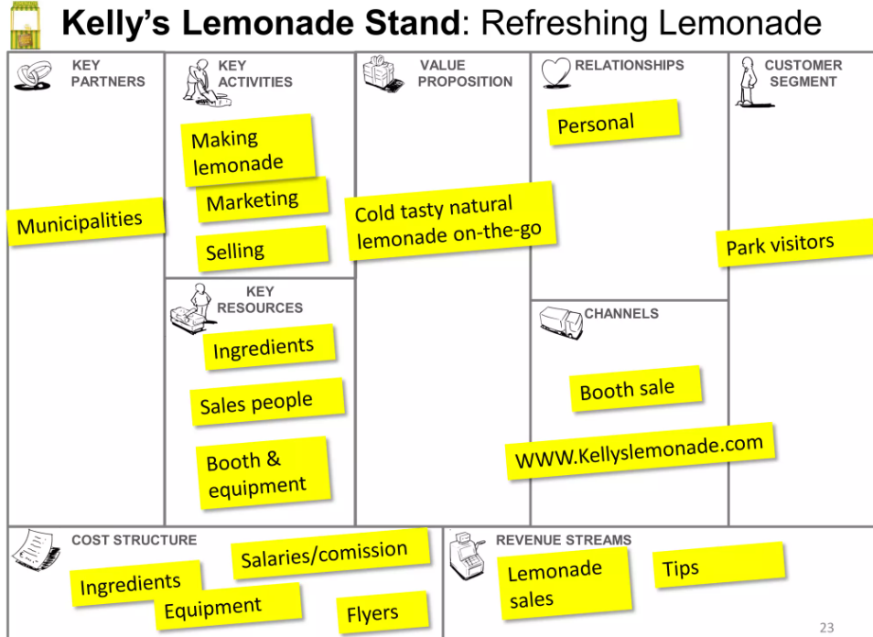

Slide 26
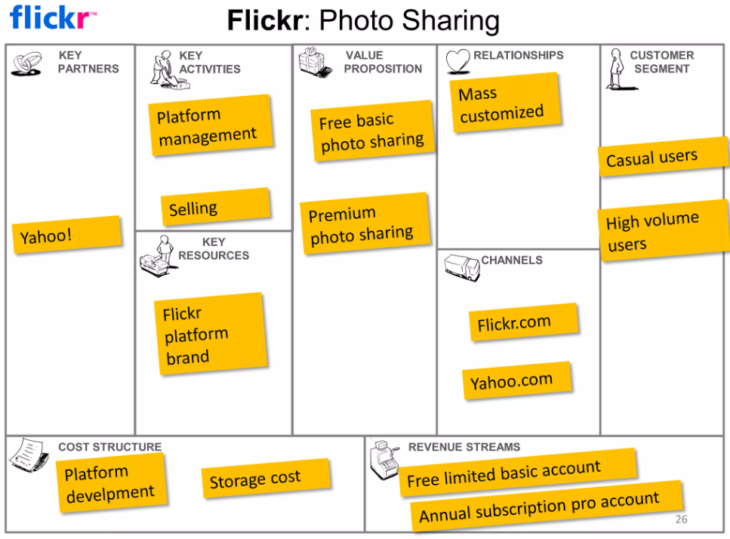

Slide 27
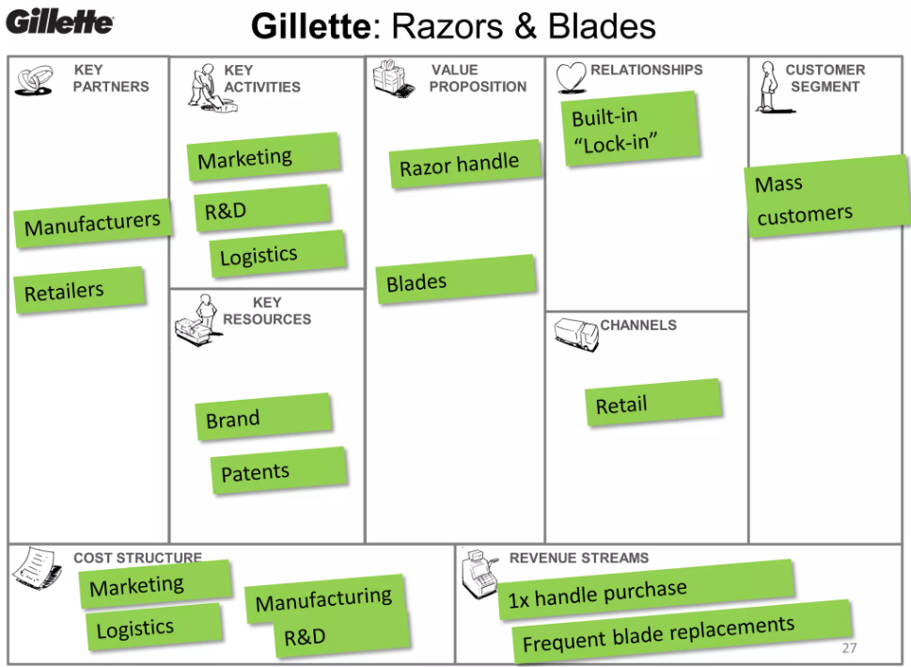

Slide 28
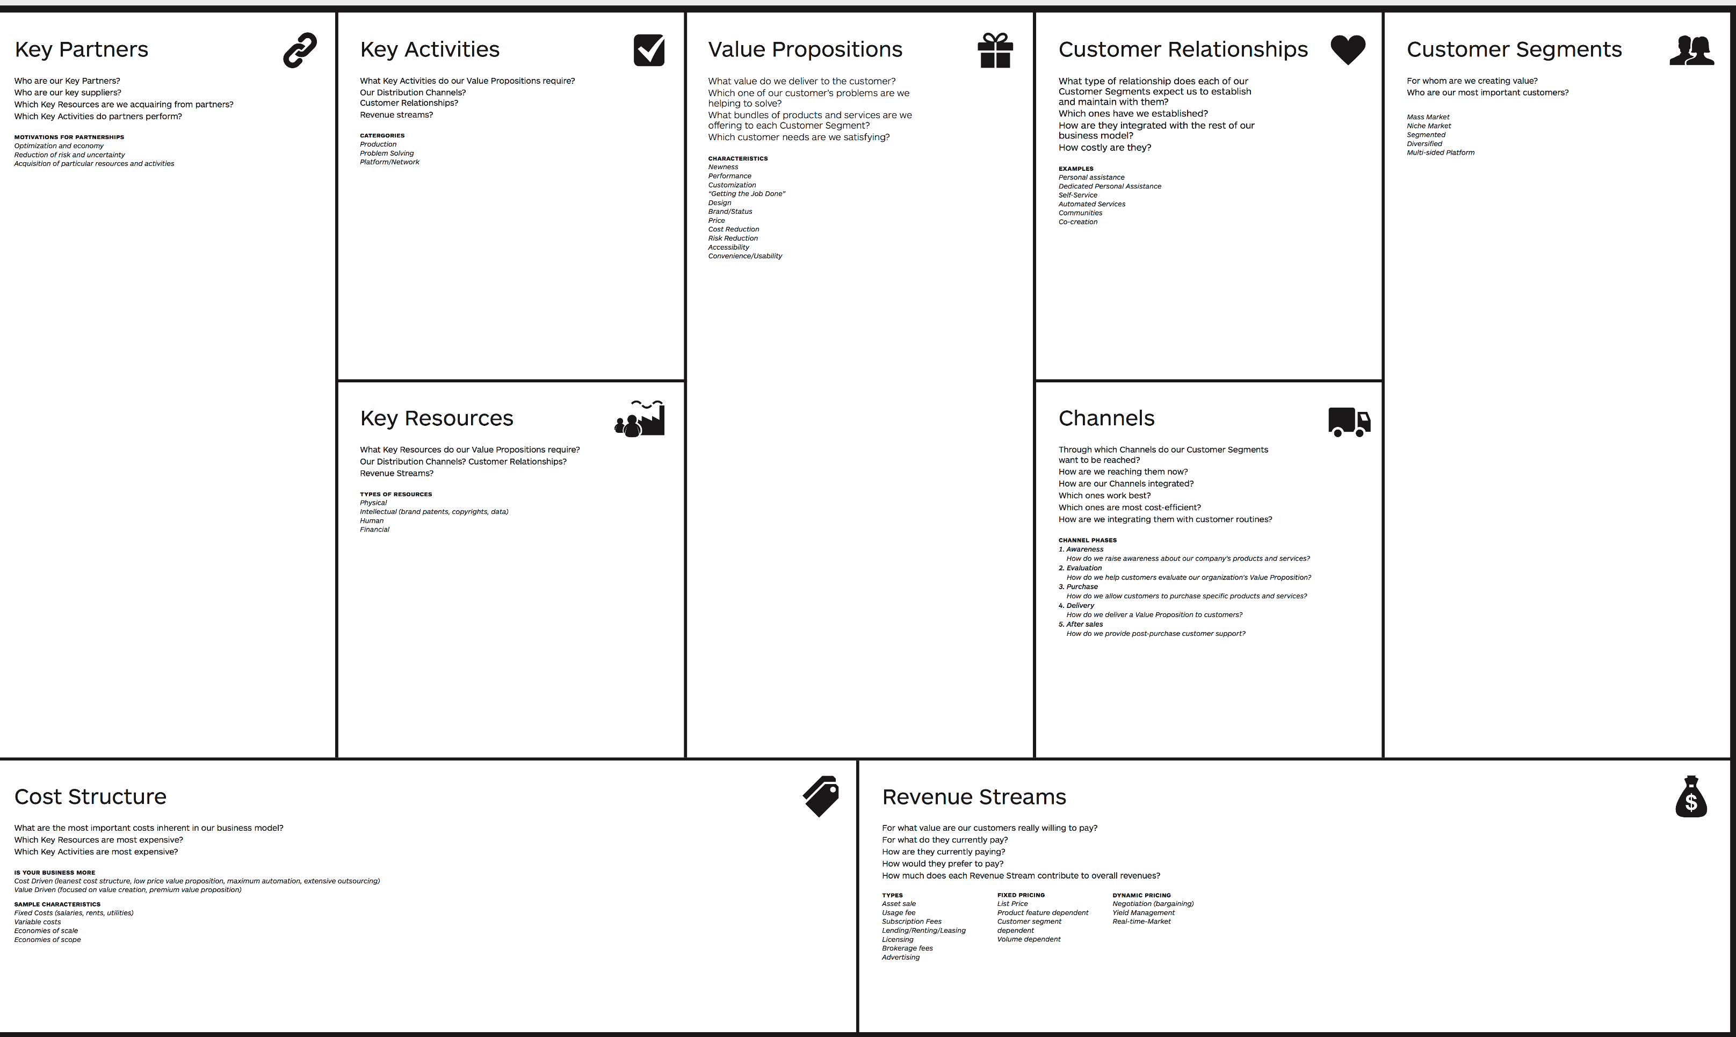

Slide 29
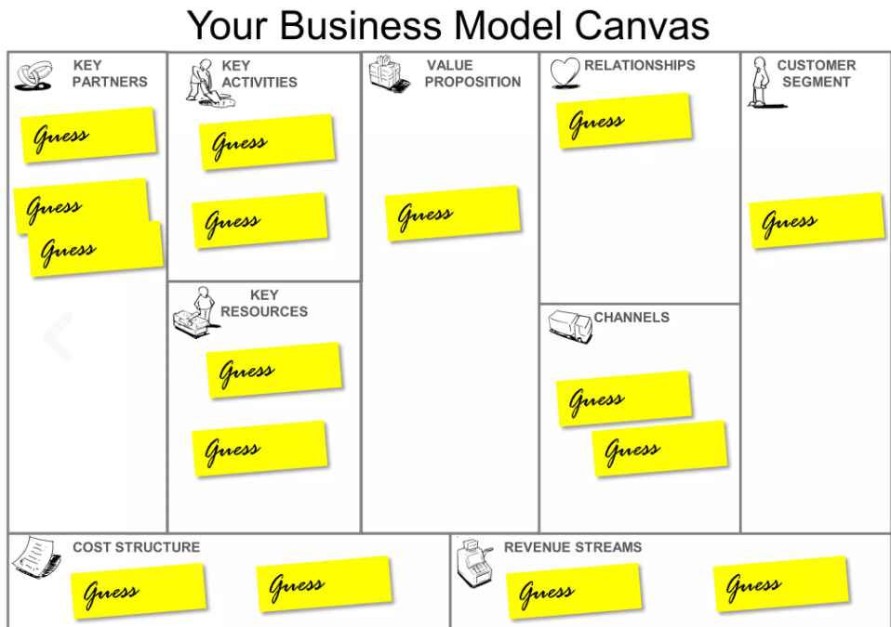

Slide 30
Thank you

